Slide 1
Financial Aid Overview

Slide 2
Agenda
What is financial aid?
Where do I find financial aid?
How do I apply?
Who can help me?

Slide 3
What is financial aid?
Monies received from federal, state, institutional or private resources
Monies are categorized as:
Gift aid
Self help
Need-based
Merit-based
Can cover direct or indirect costs
Notes:
Applying for financial aid involves multiple applications. Students and families will be applying for aid through federal, state, institutional and private resources. It is important to research all avenues! Financial Aid is divided into different categories:
Gift aid – this is free money that DOES NOT require repayment as long as the student meets the parameters outlined for each grant or scholarship. Students should always consult with a financial aid administrator prior to making any schedule changes to determine what repercussions the schedule changes will have on their financial aid awards.
Self help – this can be as easy as taking part of your earnings as applying it toward your college expenses. Students should check with their employer (or potential employers) regarding any tuition assistance or reimbursement programs being offered. Student loans are also considered as a form of “self” help, but should only be used as a last resort.
Need-based – all need-based monies are awarded based on the applicant’s Free Application for Federal Student Aid (FAFSA). Therefore, it is important to complete your FAFSA as soon as possible. While the Pell Grant is an entitlement program, other need-based monies are awarded on a first-come, first-serve basis.
Merit-based – merit-based monies are available through a variety of avenues that we will discuss throughout today’s presentation. For example, Bright Futures is a merit-based program.
College costs include: tuition, fees, books, along with other expenses such as: transportation, food, housing, clothing and computer costs. Cost of attendance can vary from institution to institution, so check your college’s website for additional information. Financial aid monies can be used toward all items included within the cost of attendance.

Slide 4
College costs
Public 2-year college (tuition and fees, in-state) - $3,347
Public 4-year college (tuition and fees, in-state) - $9,139
Public 4-year college (tuition and fees, out of state) - $22,958
Private 4-year college (tuition and fees) - $31,231
Source: bigfuture by The College Board
Notes:
College costs vary from institution to institution. There are also variances between in-state and out of state. It is important to take this into consideration when looking at your options. This slide only shows tuition and fees, but as we outlined on the previous slide, college costs include both direct and indirect costs. You can also use the Net Price Calculator to assist you in analyzing your budget. (https://bigfuture.collegeboard.org/pay-for-college/paying-your-share/focus-on-net-price-not-sticker-price).

Slide 5
FAFSA
Largest source of student aid; distributed and processed by the U.S. Department of Education
Manual or electronic options
2016-17 FAFSA opens January 1
IRS Data Retrieval Tool opens February 1and allows students to import PRIOR year tax data
2017-18 FAFSA opens October 1
IRS Data Retrieval Tool opens October 1 and will allow students to import PRIOR PRIOR year tax data
Must be completed ANNUALLY
www.fafsa.gov
Notes:
Please note that the first letter in the acronym FAFSA stands for FREE. Please make sure you are using the correct website: fafsa.gov. There are other websites with a similar look and feel that can assist you in completing the FAFSA for a CHARGE. You do not need to pay someone to assist you in this process.
While the 2016-17 application does become available January 1st, most applicants do not have their prior year tax returns completed at that point. You can complete your FAFSA using an estimate of your income and taxes and update it once your tax return is complete. Or, wait until your tax returns are finalized and complete the application then. If you do decide to wait, please ensure that you are in compliance with your institution’s priority deadline. (Review your institution’s website to determine the priority deadline as deadline’s vary from institution to institution. Also, please note that it is highly advisable to complete the application electronically and to utilize the IRS data retrieval tool. Doing so can eliminate common errors, allow you to take advantage of the online skip logic and can reduce your chances of your file being selected for verification.
Also, please note the FAFSA opening date changes between 2016-17 and 2017-18! FAFSA will also allow students to import the same tax year (2015) for both FAFSAs!

Slide 6
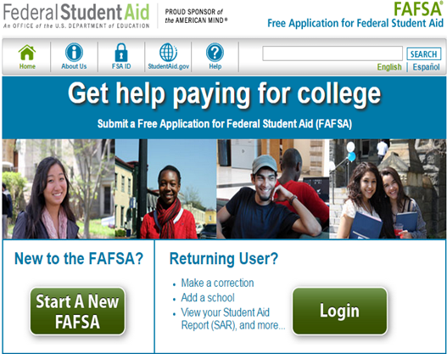
FAFSA
Help
Notes:
This is a screenshot of www.fafsa.gov. The reason that we show this screen shot is so that you can ensure you are accessing the FREE website. If you feel that you need assistance in completing this application, there are built-in help resources available online. You can also reach out to a member of our Outreach Team, your high school counselor or a financial aid professional at your institution. We can all help you at no cost. A good rule of thumb is “you should never have to pay money for free money!”

Slide 7
Getting started
Gather important data
Monitor priority deadlines
State and institutional deadlines vary
Confirm FAFSA dependency versus independency requirements
Dependent students are required to include parental information
Search for school codes
Plan to sign and submit online using the FSA ID and FSA Password
Notes:
Students will need to have their SSN, Alien Registration Numbers (if applicable), tax returns or earning statements, untaxed income records, current bank statements, current business or investment records to complete their FASFA. Again, if your tax return is not complete yet, you have the option to enter estimates! Just don’t forget to go back and make the edits once the return is finalized.
Monitoring the various deadlines is an integral part of the financial aid process. For example, the state of Florida offers need-based programs that include a FAFSA priority deadline of May 15th. Institutions also have their own FAFSA priority deadline and you can check their website for the specifics.
The FAFSA may require parental information. Students and families can review the checklist online at: https://studentaid.ed.gov/sites/default/files/fafsa-dependency.pdf to determine if parental information is needed. If parental information is needed, students and families can review the “Who is my parent” checklist at: https://studentaid.ed.gov/sites/default/files/fafsa-parent.pdf. If there are extenuating circumstances and students cannot provide parental information, they need to speak to a financial aid administrator regarding a Dependency Override. Dependency Overrides are for extenuating circumstances only, and are not applicable to parents who are unwilling to assist, students living on their own, etc.
Students can search for school codes directly within the FAFSA application and can request up to 10 institutions to receive their information. If the information needs to be sent to more than 10 institutions, students can share their DRN number (located on the student aid report) with the other institutions and their report can be downloaded separately by those alternate institutions.
Students and parents will need to apply for their own FSA ID and FSA Password. This ID and PW are used to sign the FASFA and utilize the IRS Data Retrieval Tool. Signing and submitting the FAFSA via this electronic format greatly expedites the process. Parents, if you have a FSA ID, either from your own FAFSA or in conjunction with another child, you will use that same FSA ID again. Each student filing a FAFSA will need their own FSA ID and use a SEPARATE e-mail address connected with each ID. A parent’s e-mail address cannot be used with the student ID and vice versa.

Slide 8
Student aid report
Received via e-mail within 3-5 days if you provided an email address
Received via mail within 7-10 days if you did not provide an email address
Correct errors, if needed
Will contain an expected family contribution (EFC)
Assists institutions in the financial aid award packaging process
Cost of attendance less expected family contribution = financial need
Notes:
It is important to ensure that the SAR is received and reviewed according to these timeframes. If the SAR is not received, the student must investigate why it has not been received. It may be in a spam folder, it may have not processed correctly due to an error, etc. When the student receives their copy of the SAR, the institution(s) will receive an electronic version referred to as an ISIR. If corrections need to be made, the student should work with a financial aid administrator to determine who will make the corrections (student or school). If a student needs to make corrections, they will do so online at www.fafsa.gov.
The institution will review the SAR for accuracy and begin the financial aid award process. The EFC is used to award need-based aid. As outlined on the slide, cost of attendance – EFC = financial need. An institution will begin layering a financial aid package in an effort to cover the entire cost of attendance. As the cost of attendance can vary from institution to institution, it is important that students and families apply through all federal, state, institutional and local resources in an effort to assist the institution in building a strong financial aid package. It is a group effort!

Slide 9
Additional info
Contact institution to determine award process
Contact institution for special circumstances or professional judgment needs
Contact institution to determine what other types of aid applications are available
Use student loans as a LAST RESORT
Notes:
Students must contact their institution to determine the award process. For example, one institution may email the student. Another may require the student to log-in to a student portal and check their status online. The student must monitor the process closely! Otherwise, they may miss out on key deadlines or funding.
If students and families complete the FAFSA and are concerned that the form does not reflect their current situation, they may contact a financial aid administrator to discuss their specific needs. Professional judgment is optional and schools have the direct authority in this area. For more information, please visit http://www.finaid.org/educators/pj/.
Students can also contact the institution to determine what other aid applications are available. An institution may have a foundation department that has a separate application and funding process that students may want to apply for. Additionally, department chairs may have access to not only institutional funds, but may also have access to other industry-based resources students can apply for.
Lastly, student loans are often included in the initial award process. Students have a right and responsibility to determine if they should accept, decline or reduce any student loan or loans being offered. Students must borrow conservatively. It’s important to live frugally while in college. If a student does not borrow conservatively and live frugally while in college, he/she will struggle throughout student loan repayment.

Slide 10
FFAA
The Florida Financial Aid Application opens December 1 of the senior year
Apply early - must be completed prior to August 31
One application is used for multiple programs, not just the Florida Bright Futures Scholarship Program
Must log-in to check status, online notifications and award history
www.floridastudentfinancialaid.org
Notes:
Students often refer to the FFAA as the “Bright Futures” application. It’s actually more than that! This one application assists OSFA in determine eligibility for a variety of state grants and scholarships that we will review over the next few slides. One common misconception is that students do not need to complete the application if they do not feel they will qualify for the Bright Futures program. This is NOT true. We encourage ALL students to complete the application and give OSFA the opportunity to determine their eligibility for all Florida grants and scholarships. Another common misconception is that students do not need to complete the application if they are planning to attend school out of state. This is NOT true either. We encourage you to complete it anyway and have it as your “Plan B” in case those northern winters are too cold for your Florida blood! Note: Students graduating high school in 2012-13 or later are eligible to accept an initial Bright Futures award within two years following high school graduation and to accept a renewal award for five years following high school graduation.

Slide 11
FFAA
Notes:
Briefly describe how to navigate the website based on the included screen shots.

Slide 12
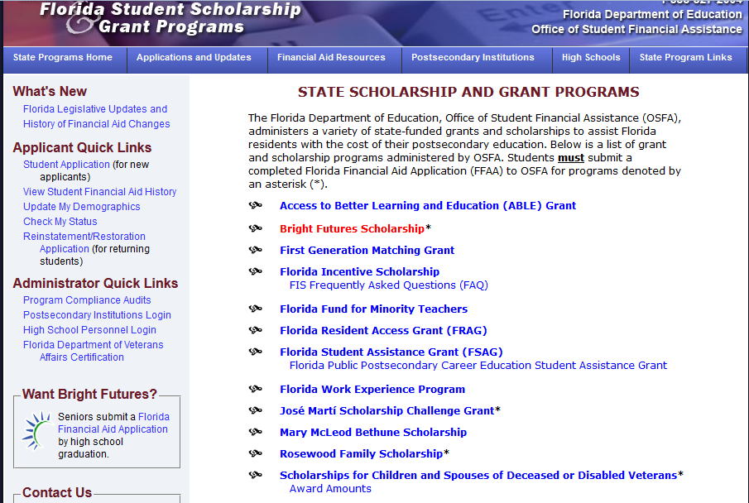
Notes:
Briefly describe how to navigate the website based on the included screen shots.

Slide 13
Notes:
Briefly describe how to navigate the website based on the included screen shots.

Slide 14
Grants
Access to Better Learning and Education (ABLE)
Florida Resident Access (FRAG)
Florida Student Assistance (FSAG)
Jose Marti Scholarship Challenge (JM)
Notes:
ABLE - Provides tuition assistance to full-time Florida undergraduate students enrolled in degree programs at eligible private Florida colleges or universities.
FRAG - Provides tuition assistance to full-time Florida undergraduate students who attend eligible private, non-profit Florida colleges or universities.
FSAG - Florida’s largest need-based grant program provides assistance to degree-seeking, resident, undergraduate students who demonstrate financial need and are enrolled in eligible public or private postsecondary institutions. FAFSA is required by the deadline specified by the participating postsecondary institutions.
Jose Marti - Provides scholarship assistance to Hispanic-American students who meet scholastic requirements and demonstrate financial need. Applicants for undergraduate study must apply during their senior year of high school. Graduate students may apply; however, priority for the scholarship is given to graduating high school seniors. To be considered, high school seniors must submit a completed (error free) Initial Student Florida Financial Aid Application (FFAA) and provide supporting documentation
by April 1st. FAFSA is also required and must be processed by the U.S. Department of Education by the May 15th deadline. Students are ranked according to highest GPA (4.0) and lowest EFC (zero). Awards are made until the allocation has been used up.

Slide 15
Scholarships
Bright Futures (BF)
Student Handbook
Chart of Eligibility and Award Criteria
Florida Incentive (FIS)
Mary McLeod Bethune (MMB)
Rosewood Family (RFS)
Scholarships for Children and Spouses of Deceased or Disabled Veterans (CSDDV)
Notes:
BF - Provides scholarships based on high school academic achievement and is Florida’s largest merit-based scholarship program. To be considered, students must submit a completed (error free) Initial Student Florida Financial Aid Application (FFAA) during their senior year of high school (after December 1st and prior to August 31). Students graduating mid-year must submit the completed FFAA by August 31st of their graduation year (prior to the spring term enrolled). Print out Student Handbook and Chart of Eligibility and Award Criteria for additional speaking points during this part of the presentation. (i.e., test scores, community service hours, etc.)
FIS –is a merit scholarship for 2013-14 Florida high school graduates and thereafter who receive recognition as a National Merit® or National Achievement® Scholar.
Eligible scholars will receive an award, which is equal to the institutional cost of attendance minus the sum of Bright Futures and the National Merit/Achievement® award.
An initial application is not required.
MMB - Provides scholarship assistance to undergraduate students who meet academic requirements, demonstrate financial need, and attend Bethune-Cookman University, Edward Waters College, Florida Agricultural and Mechanical University, or Florida Memorial University. For participation and application deadline information, students should check with the postsecondary institutions they plan to attend.
RFS - Provides scholarship assistance to a maximum of 25 50 direct descendants of Rosewood families affected by the incidents of January 1923 to attend full-time at eligible state universities, Florida Colleges (public community colleges), or public postsecondary vocational technical schools. Complete, error free Initial Student Florida Financial Aid Application (FFAA) is due by April 1st. FAFSA is also required and must be processed by the U.S. Department of Education by the May 15th deadline.
CSDDV - Provides scholarship assistance for dependent children and spouses of Florida veterans who:
• died as a result of service-connected injuries, diseases, or disabilities sustained while on active duty, or
• have been verified by the Florida Department of Veterans Affairs as having service-connected 100% total and permanent
disabilities, and
• Dependent children whose parent is classified as a prisoner of war or missing in action by the Armed Forces of the U.S. or in the capacity of civilian personnel captured while serving with the consent or authorization of the U.S. Government during wartime service are also eligible. To be considered, students must submit a completed (error free) Initial Student Florida Financial Aid Application (FFAA) by April 1st. The Florida Department of Veterans Affairs will certify a veteran’s eligibility.

Slide 16
Other
First Generation Matching Grant (FGMG)
Florida Fund for Minority Teachers (FFMT)
Florida Work Experience Program (FWEP)
Money for College - 2014-15 Florida Scholarships and Grants
Notes:
FGMG - Provides grant funding to Florida resident, undergraduate students enrolled at state universities or Florida Colleges (public community colleges), who demonstrate financial need, and whose parents have not earned baccalaureate degrees. To be considered, students must submit a completed (error free) Free Application for Federal Student Aid (FAFSA) by the deadline specified by the participating postsecondary institutions. For participation and application deadline information, students should check with the postsecondary institutions they plan to attend.
FFMT - Provides scholarship funding for African-American, Hispanic-American, Asian-American, and Native-American students who indicate the potential to become good teachers. Eligible initial students must have met United States citizenship and Florida residency requirements, have earned 60 credit hours or an Associate of Arts degree, have not exceeded 18 hours of upper division educational courses, be juniors, not have received a baccalaureate degree in education, have a minimum 2.5 GPA, and be newly admitted into a teacher education program at any of the program’s participating postsecondary institutions. To be considered, students must apply via the Florida Fund for Minority Teachers website at www.ffmt.org.
FWEP - Provides eligible Florida resident, undergraduate students the opportunity to secure work experiences that complement and reinforce their educational programs and career goals. To be considered, students must submit a completed (error free) Free Application for Federal Student Aid (FAFSA) by the deadline specified by the participating college, university, Florida College (public community college), career center operated by a district school board, or educator preparation institute. For information on participating employers and institutional application deadlines, students should check with the postsecondary institutions they plan to attend.

Slide 17
2015-16 award amounts
ABLE $1,500 annually
BF (FAS) $52 to $103 per CH
BF (FMS) $39 to $77 per CH
BF (GSV) $39 to $48 per CH
CSDDV tuition and registration fees public annually
flat rate (private)
FGMG determined by need annually
FFMT up to $4,000 annually
FIS COA less BF/NMS awards annually
FRAG $3,000 annually
FSAG $2,610 max to $200 min annually
FWEP determined by need annually
JM $2,000 annually
MMB $3,000 annually
RFS tuition & fees up to $6,100 annually
Notes:
Award amounts are determined annually during the Florida Legislative Session. 2016-17 award amounts will be posted on/after July 1.
BF – FAS
4 year – $103.00
2 year – $63.00
CC Baccalaureate – $71.00
Career/Technical - $52.00
Academic Top Scholar $44.00 per credit hour
BF – FMS
4 year – $77.00
2 year – $48.00
CC Associate - $63.00
CC Baccalaureate – $53.00
Career/Technical - $39.00
BF – GSV
Career Certificate - $39.00
Applied Technology Diploma - $39.00
Technical Degree Education – $48.00

Slide 18
FloridaShines.org
FloridaShines.org is Florida's official online student advising system that can assist high school students, college students, parents, and even counselors to help plan and track educational progress in Florida
Bright Futures Scholarship Eligibility Evaluation
www.floridashines.org
Notes:
Florida Shines (formerly FLVC) is different than the Florida Virtual School. Florida Shines has a variety of resources to assist students and families prepare for college.

Slide 19
FloridaShines.org
Notes:
This screenshot shows where the Bright Future Scholarship Eligibility Evaluation is located under the “Go To College” section. Then click on “Pay for College.” Scroll down the “Bright Futures Scholarship” section and click on “Check for eligibility for a Bright Futures Scholarship now.” Students must sign in with their user id and password. It’s ok if they forgot it though! There is a forgot userid/password link! Note: Students may known this log-in as their facts.org userid/password.

Slide 20
Fastweb
1.5 million scholarships worth 3.4 billion dollars
Targeted search
Other resources
College search
Career planning
And more!
www.fastweb.com
Notes:
TIP- Set up a separate email account solely for scholarship searches to prevent your personal inbox becoming inundated with information.
Fastweb works by matching the information in your completed profile to scholarships contained in their database. Besides providing you with scholarships you actually qualify for, and eliminating the need to scour the web, Fastweb also provides advice on financial aid, college admissions, student life and tools such as financial aid calculators, discussion boards, and checklists.

Slide 21
Other
www.finaid.org
High School or School District
Protect yourself from scams
Report to www.ftc.gov
Notes:
Finaid.org offers a great list of scholarships. The list includes a section called “unusual scholarships” that include items such as Star Trek scholarships, Left-handed scholarships, Tall People/Little People scholarships, students with disabilities, medical conditions (i.e., cancer survivors), etc.
Your high school guidance office is a great resource for local scholarships. Many local employers will contact the high school guidance office to advertise their scholarship applications and guidelines. Your school district may also provide an online resource for you too. so check out the district website for additional information.
As we discussed earlier, “You should never pay money for free money!” We all know that old saying, “If something sounds to good to be true, it probably is!” Protect yourself from companies that attempt to pressure you into paying for resources that you can easily access yourself at no cost. Suspicious activity should be reported to the Federal Trade Commission.

Slide 22
Education credits
Education tax credits (i.e., American Opportunity and Lifetime Learning Credits) can offset the costs of education
Subtracted in full from the federal income tax, not just deducted from taxable income
Notes:
Please refer to IRS Publication 970 (http://www.irs.gov/pub/irs-pdf/p970.pdf) for additional information or consult with your local tax advisor for additional information.

Slide 23
MYF
Mapping Your Future is a non-profit organization dedicated to combining person-to-person financial counseling with online resources to help students plan for the future
College preparation
School selection
Career exploration
Money management
www.mappingyourfuture.org
Notes:
Through OSFA’s sponsorship, all of MYF products and services are free of charge to Florida’s students and families. Mapping Your Future’s goal is to help students plan for higher education by offering reliable and unbiased money management advice and counseling. Online and offline resources include college preparation, school selection, career exploration, and counseling aimed at helping students and families better understand student loan obligations and learn about practical money management solutions to ensure healthy finances while in school and beyond.

Slide 24
NyFF
Financing higher education
Managing day-to-day money
Career planning
School/Life management
www.navigatingyourfuture.org
Notes:
Throughout this entire presentation, you have seen the NyFF logo in the upper left-hand corner. Have you been wondering what that is all about? Well, let me tell you! OSFA creating “Navigating Your Future” to help students and families just like you in making decisions regarding your educational and financial future. NyFF has a variety of resources available in print and online, so check it out today!

Slide 25
Contact us
E-mail: osfa@fldoe.org
Telephone: 1-888-827-2004
OSFA Outreach Team
www.NavigatingYourFinancialFuture.org/ContactUs.aspx
Notes:
If you need assistance or further information, please do not hesitate to contact us. We are here to help!

