Slide 1
Testing
Mrs. Williams – Assessment Coordinator
Room 5-105
Notes:
Be specific and direct in the title. Use the subtitle to give the specific context of the speech.
-The goal should be to capture the audience’s attention which can be done with a quote, a startling statistic, or fact. It is not necessary to include this attention getter on the slide.

Slide 2
English
9th Grade FAST
PM 1
August or September
90-minute min.
40 questions
PM 2
January
90-minute min.
40 questions
PM 3
May
120-minute min.
10th Grade FAST
PM 1
August or September
90-minute min.
40 questions
PM 2
January
90-minute min.
40 questions
PM 3 *
Passing is a graduation requirement
May
120-minute min.
Notes:
Use the background points to post details that are not common knowledge, or that the audience will need to understand the context of the speech.
-Do not read these main points from the PowerPoint, instead elaborate on these points during the speech.

Slide 3
English Concordant Score
10th Grade FAST PM3 – Level 3
SAT EBRW – 480
ACT English and Reading Average – 18
CLT Verbal Reasoning and Grammar/Writing sections sum - 36

Slide 4
BEST Writing
9th and 10th Grade
April
120 minutes
Notes:
The counterargument should be the most common argument against the topic. The goal for this slide is to address the counterargument in such a way as to actually strengthen the original topic. Be sure to address each piece of evidence against the topic. As you address each piece of evidence elaborate on the text found on the slide. Remember to transition to the final slide, the action step.

Slide 5
Math
BEST Geometry
May
160-minute min.
30% of final grade
BEST Algebra 1
May
160-minute min.
Passing is a graduation requirement (level 3 or higher)
30% of final grade
Notes:
The counterargument should be the most common argument against the topic. The goal for this slide is to address the counterargument in such a way as to actually strengthen the original topic. Be sure to address each piece of evidence against the topic. As you address each piece of evidence elaborate on the text found on the slide. Remember to transition to the final slide, the action step.

Slide 6
Alg Concordant Score
PSAT/NMSQT Math - 430
SAT Math - 420
ACT Math - 16
CLT Quantitative Reasoning Section -11
Geometry EOC - Level 3
Notes:
The counterargument should be the most common argument against the topic. The goal for this slide is to address the counterargument in such a way as to actually strengthen the original topic. Be sure to address each piece of evidence against the topic. As you address each piece of evidence elaborate on the text found on the slide. Remember to transition to the final slide, the action step.

Slide 7
Science & History
US History EOC
May
160-minute min.
30% of final grade
Biology EOC
May
160-minute min.
30% of final grade
FCLE
December & April/May
160-minute min.
Florida College or University graduation requirement

Slide 8
Historically State/District Funded Tests
Reportable
PSAT
October
All 10th Grade Students
SAT SD
March
All 11th Grade Students
Not College Reportable
SAT NCR
October
12th Grade Students

Slide 9
Student Paid Testing Opportunities
Not College Reportable
ACT NCR
March 25th -27th
11th & 12th Grade Students who have not yet met high school testing requirements
$40
Reportable
SAT - $68
ACT - $65
CLT
$34.50 on campus
$69 remotely proctored at home
(All of these tests offer financial assistance contact your school counselor for more information)

Slide 10
Communication
Email sent to student’s school email address
Email sent to parent/guardian’s email address
Lists posted outside of Student Services, the front of the media center, and outside my office 5-105
Testing lists are also provided to all teachers

Slide 11
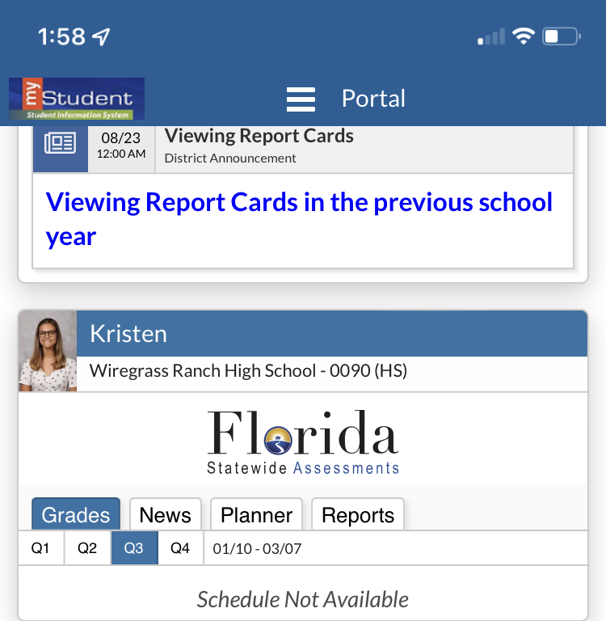
Scores
Algebra, Geometry, FCLE, and FAST Scores are returned the same day
Biology, and US History are returned in 2 weeks
Follow the link in myStudent

Slide 12
Miscellaneous
Attendance
Students are marked absent if not in class
If students were testing, the attendance is corrected in 24-48 hours
Cell phone policy
Most Common cause of invalidation
No Cell Phone, No AirPods/ Bluetooth Headphone, No Smart Watches
We test EVERY DAY in May

